Slide 1
Face Anti-Spoofing
BTech Project Presentation
By: Tadi Dinesh Kumar Reddy (200001075)
Under supervision of: Dr. Surya Prakash

Slide 2
Recap

Slide 3
Searching Central Difference Convolutional Networks for Face Anti-Spoofing
Official implementation:
https://github.com/ZitongYu/CDCN/tree/master
OULU-NPU, SiW, CASIA-MFSD, Replay-Attack, MSU-MFSD and SiW-M datasets used
Unofficial:
https://github.com/laoshiwei/face-anti-spoofing
Uses NUAA dataset (~400mb)
Paper:
https://openaccess.thecvf.com/content_CVPR_2020/papers/Yu_Searching_Central_Difference_Convolutional_Networks_for_Face_Anti-Spoofing_CVPR_2020_paper.pdf

Slide 4
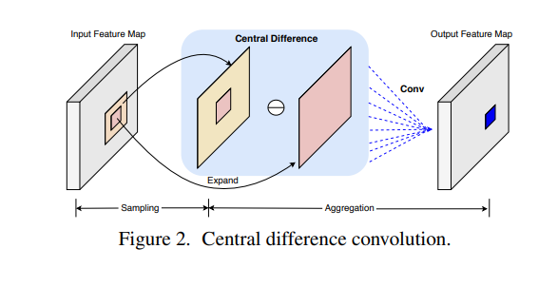
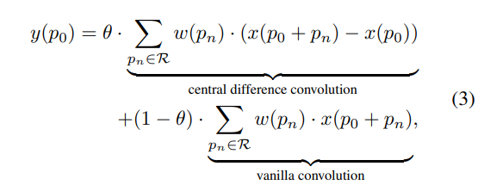
Searching Central Difference Convolutional Networks for Face Anti-Spoofing
CDC implementation:
For face anti-spoofing task,
both the intensity-level semantic info,
gradient-level detailed info are
crucial for distinguishing
the living and spoofing faces
So, a more generalized formula would be

Slide 5
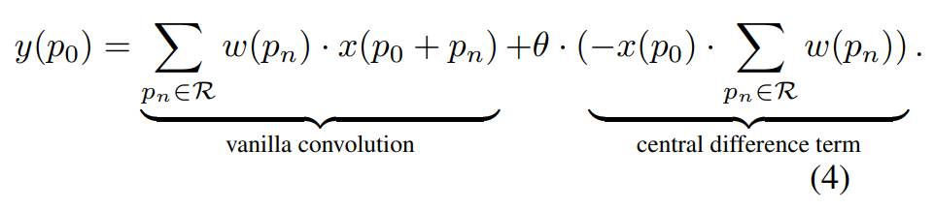

Searching Central Difference Convolutional Networks for Face Anti-Spoofing
CDC implementation:

Slide 6
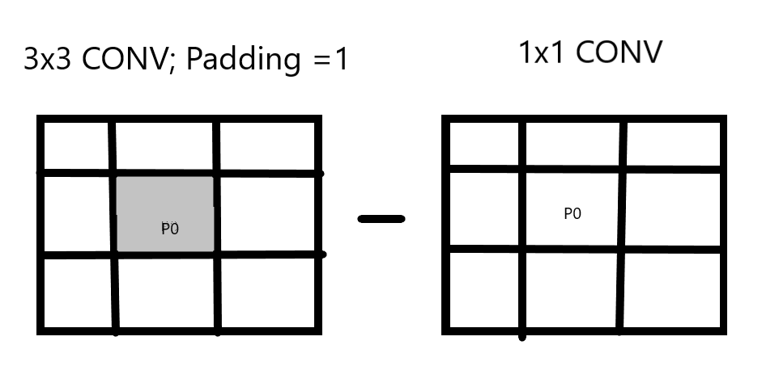
Searching Central Difference Convolutional Networks for Face Anti-Spoofing
CDC implementation:

Slide 7
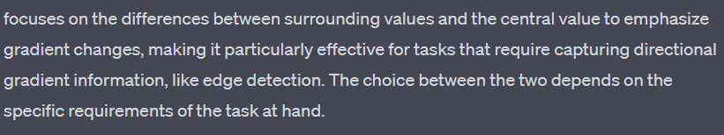
Searching Central Difference Convolutional Networks for Face Anti-Spoofing
CDC prefers to aggregate center-oriented gradients of the sampled values. The center-oriented gradient refers to the difference between the central value of the sampled region and the average of the surrounding values. This difference emphasizes the gradient changes that are centered around the current position. Aggregating these center-oriented gradients rather than the raw values allows the convolution to be more sensitive to changes in the center of the receptive field.

Slide 8
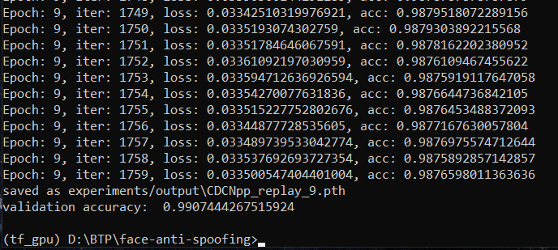
Searching Central Difference Convolutional Networks for Face Anti-Spoofing
Unofficial implementation: Using processed Replay-Attack (15k train, 10k validation)

Slide 9
Deep Pixel-wise Binary Supervision for Face Presentation Attack Detection
Official implementation:
https://gitlab.idiap.ch/bob/bob.paper.deep_pix_bis_pad.icb2019
Uses BOB software
Replay-Mobile and OULU-NPU datasets were used
Unofficial:
https://github.com/Saiyam26/Face-Anti-Spoofing-using-DeePixBiS
Uses NUAA dataset (~400mb)
Paper:
https://arxiv.org/pdf/1907.04047v1.pdf

Slide 10
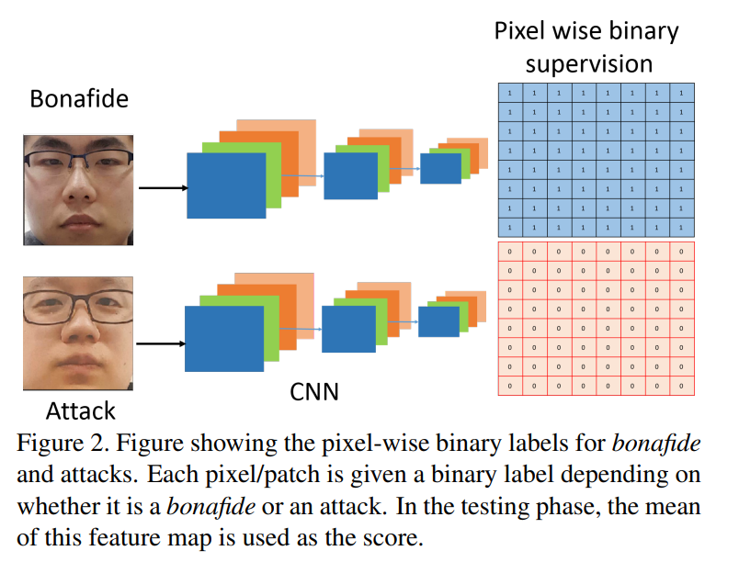
Deep Pixel-wise Binary Supervision for Face Presentation Attack Detection

Slide 11
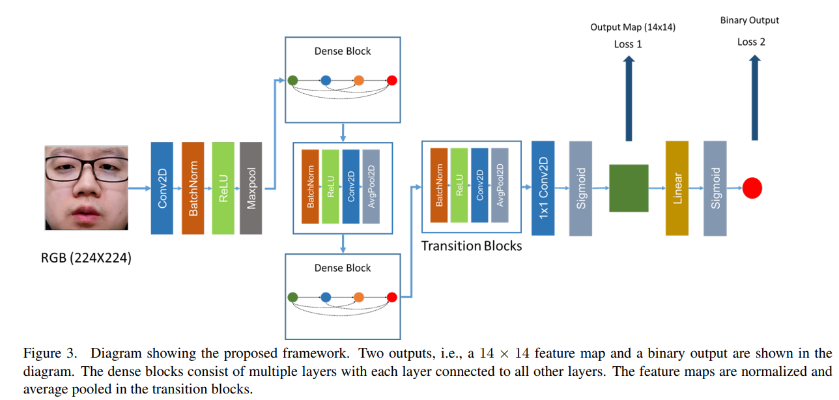
Deep Pixel-wise Binary Supervision for Face Presentation Attack Detection

Slide 12
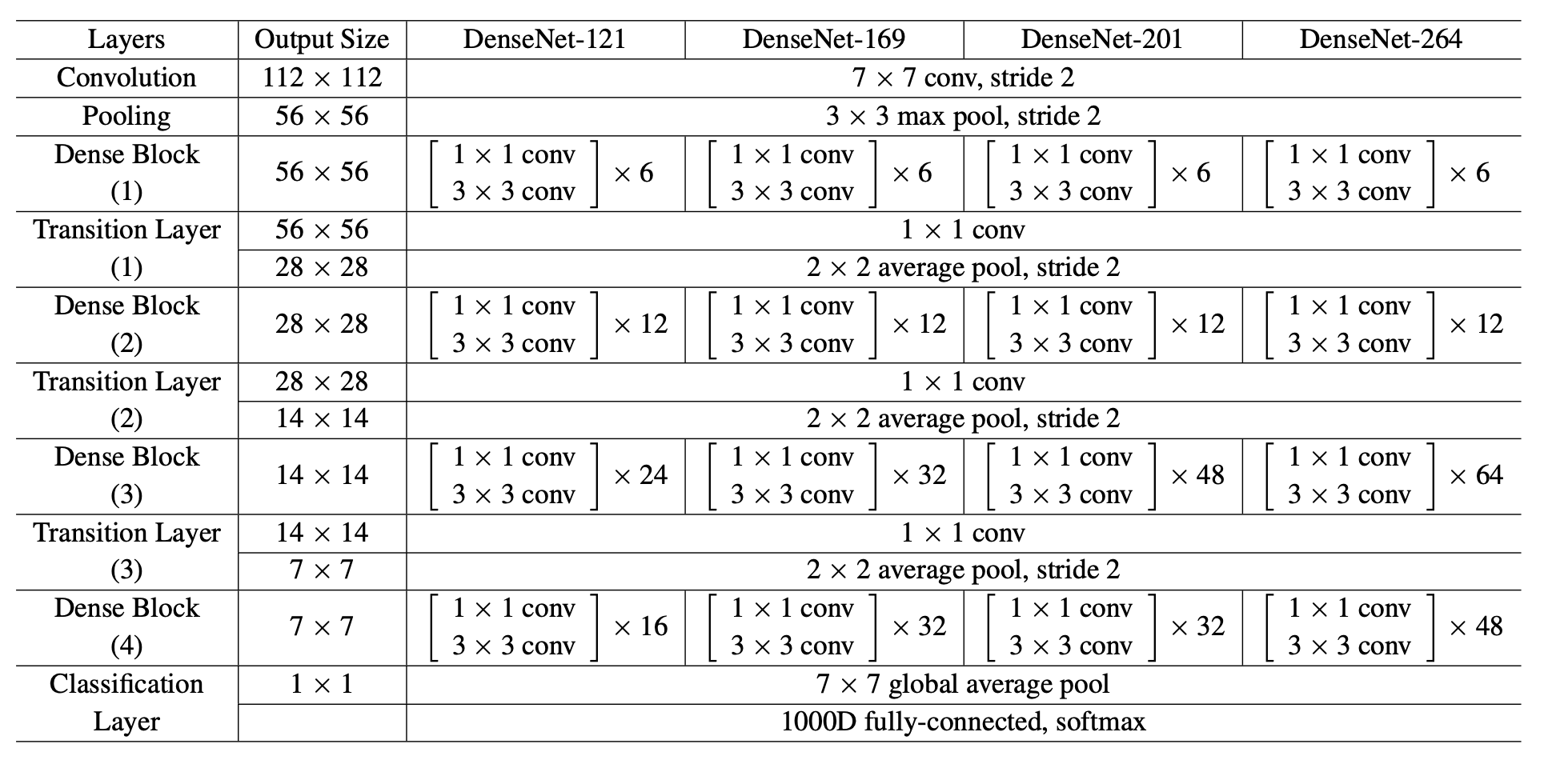
Deep Pixel-wise Binary Supervision for Face Presentation Attack Detection
Image reference: https://pytorch.org/hub/pytorch_vision_densenet/

Slide 13
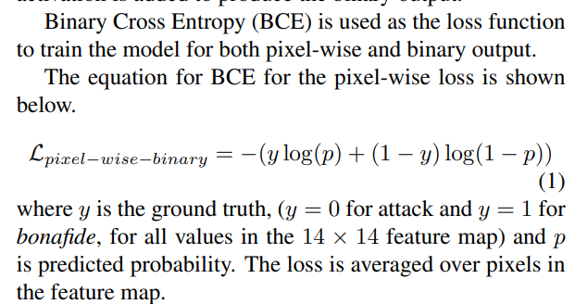
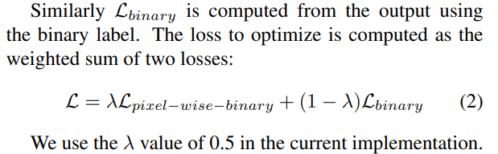
Deep Pixel-wise Binary Supervision for Face Presentation Attack Detection
Binary loss (Bona fide or PA)
Loss 2 in architecture shown
Pixel-wise-binary loss (depth loss)
Loss 1 in architecture shown

Slide 14
On the Effectiveness of Vision Transformers for Zero-shot Face Anti-Spoofing
Official implementation:
https://gitlab.idiap.ch/bob/bob.paper.ijcb2021_vision_transformer_pad
HQ-WMCA and SiW-M datasets used
Paper:
https://arxiv.org/abs/2011.08019

Slide 15
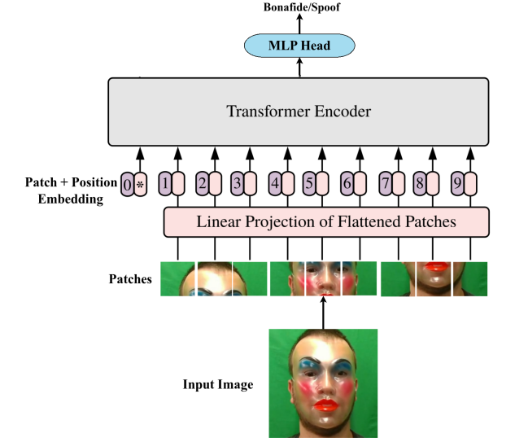
On the Effectiveness of Vision Transformers for Zero-shot Face Anti-Spoofing
ViT used : https://github.com/google-research/vision_transformer
(https://arxiv.org/abs/2010.11929)
The last layer is replaced with a
fully connected layer with one output node
and the model is fine-tuned using BCE loss.
The training and evaluation components
were implemented using the Bob2 library.

Slide 16
On the Effectiveness of Vision Transformers for Zero-shot Face Anti-Spoofing
For training, the pre-trained vision transformer model is taken and the final classification head is removed.
A new fully connected layer is added on top of the embedding followed by a sigmoid layer and trained with BCE loss.
“Adapting only the FC layer achieves the best results.”
Self-attention as opposed to convolutions helps to attend to all pairwise interactions in the lower layers.

Slide 17
CDCN, DenseNet and ViT experiments

Slide 18

DenseNet with CDCN
Replaced the 3x3 kernel nn.conv2D operation with CDC operator
While leaving the 1x1 kernel operations as normal.
Modified the Densenet-161 architecture from Pytorch official Github page (https://github.com/pytorch/vision/blob/main/torchvision/models/densenet.py#L251)
Ran code by modifying and using the training code from CDCN code

Slide 19
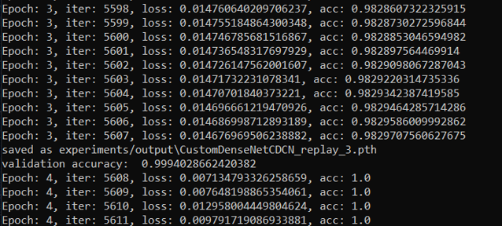
DenseNet with CDCN
Training loss and accuracy: Processed Replay-Attack (training converges within 3 epochs)

Slide 20
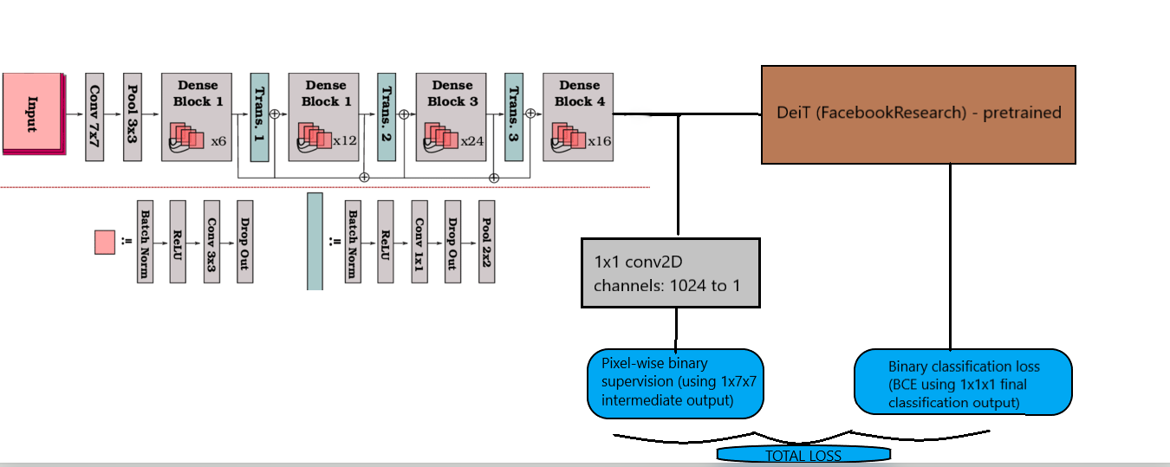
ViT(Deit) with Densenet backbone using Pixel wise binary supervision
Model Diagram
Densenet121 backbone

Slide 21
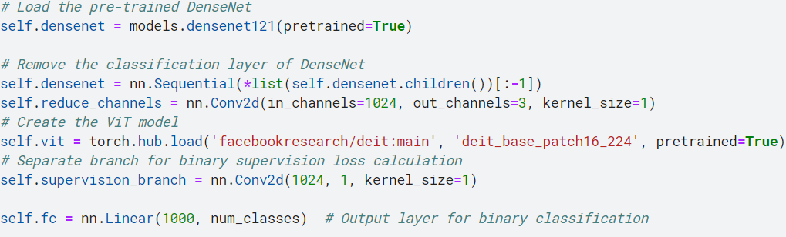
ViT(Deit) with Densenet backbone using Pixel wise binary supervision
We are using the pretrained Densenet121 and DeiT (Data-efficient Image Transformer)
With the densenet being used as the backbone

Slide 22
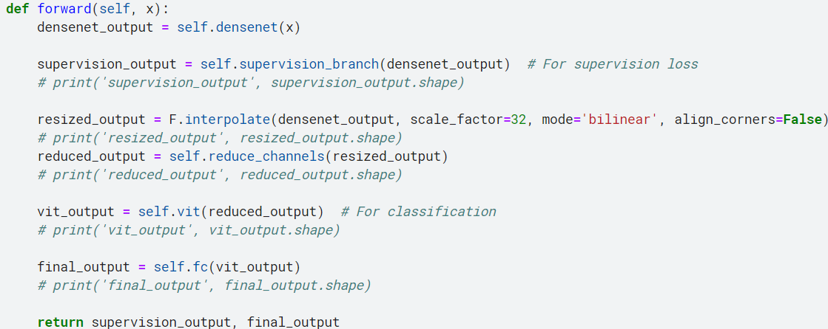
ViT(Deit) with Densenet backbone using Pixel wise binary supervision
The intermediate outputs from backbone are used for Pixel wise binary supervision
And the final output from the ViT is used for binary classification.

Slide 23
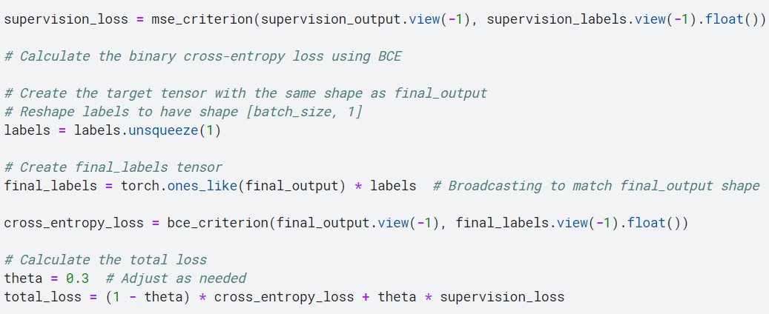
ViT(Deit) with Densenet backbone using Pixel wise binary supervision
Loss function: Total loss denoted with a weighted average of the
final binary classification loss (BCE loss) and pixel-wise binary supervision loss (MSE loss)

Slide 24
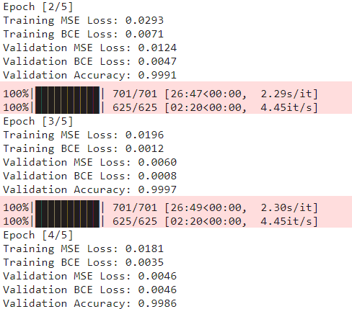
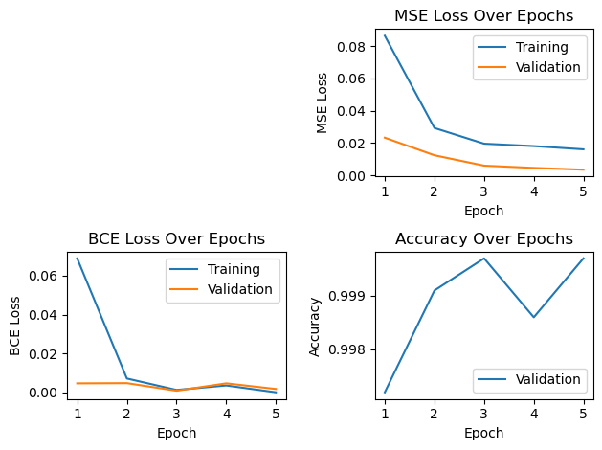
ViT(Deit) with Densenet backbone using Pixel wise binary supervision
Training loss and accuracy: Processed Replay-Attack (training converges within 3 epochs)

Slide 25
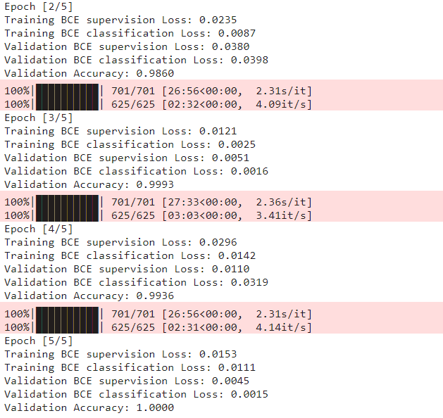
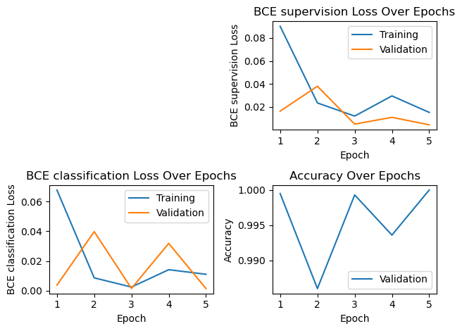
ViT(Deit) with Densenet backbone using Pixel wise binary supervision
Training loss and accuracy: Using BCE loss for both pixel wise binary supervision and binary classification

Slide 26
References
Links
https://github.com/ZitongYu/CDCN/tree/master
https://github.com/laoshiwei/face-anti-spoofing
https://gitlab.idiap.ch/bob/bob.paper.deep_pix_bis_pad.icb2019
https://github.com/Saiyam26/Face-Anti-Spoofing-using-DeePixBiS
https://arxiv.org/pdf/1907.04047v1.pdf
https://openaccess.thecvf.com/content_CVPR_2020/papers/Yu_Searching_Central_Difference_Convolutional_Networks_for_Face_Anti-Spoofing_CVPR_2020_paper.pdf
http://parnec.nuaa.edu.cn/_upload/tpl/02/db/731/template731/pages/xtan/NUAAImposterDB_download.html
https://www.researchgate.net/publication/334170752_Leveraging_Sparse_and_Dense_Features_for_Reliable_State_Estimation_in_Urban_Environments
https://ieeexplore.ieee.org/stamp/stamp.jsp?arnumber=9484333

Slide 27
References
Papers
Yu, Zitong, et al. "Searching central difference convolutional networks for face anti-spoofing." Proceedings of the IEEE/CVF Conference on Computer Vision and Pattern Recognition. 2020.
George, Anjith, and Sébastien Marcel. "Deep pixel-wise binary supervision for face presentation attack detection." 2019 International Conference on Biometrics (ICB). IEEE, 2019.
George, Anjith, and Sébastien Marcel. "On the effectiveness of vision transformers for zero-shot face anti-spoofing." 2021 IEEE International Joint Conference on Biometrics (IJCB). IEEE, 2021.

